Slide 1


Data visualisation and storytelling
1.2: Principles & guidelines
Neil Scheidwasser
09.2023

Slide 2



Slide 3
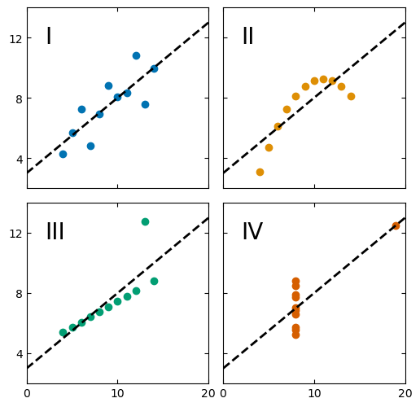
Quiz time!
2 minutes.
For each plot, guess the value of the:
Mean
Correlation coefficient

Slide 4
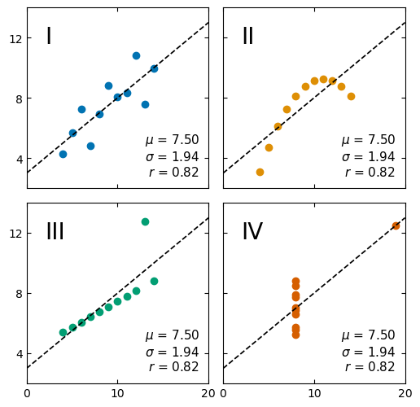
Why do we visualise data?
Graphics go beyond statistical summaries
Data visualisation can be:
Exploratory: to reveal, discover patterns in a dataset
Explanatory: to communicate information concisely to the public, to a journal…

Slide 5
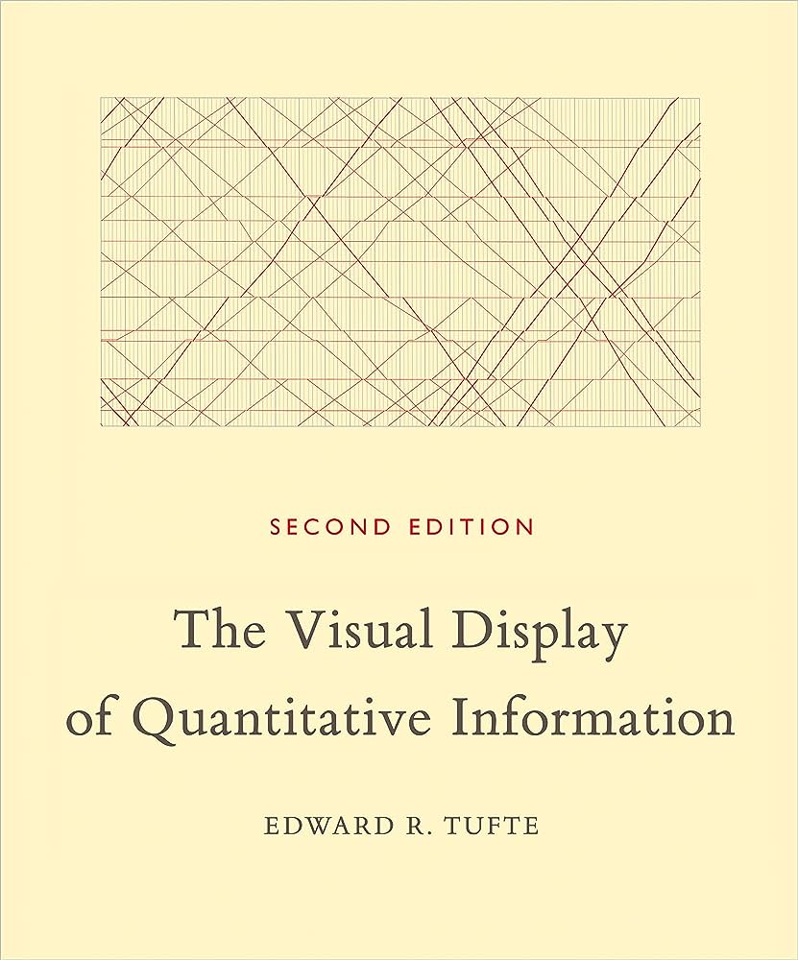
“Graphical excellence”
Graphical excellence = presenting interesting data well
Substance
Statistics
Design
Communicate complex ideas with clarity, precision and efficiency
Giving the greatest number of ideas:
In the shortest time
With the least ink
In the smallest space
Preferring multivariate plots (nearly always)
Telling the truth about the data

Slide 6

Good practices for “graphical excellence”

Slide 7
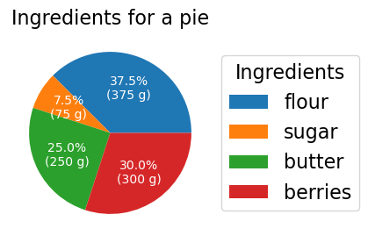
1. Prefer tables to graphics for small datasets
→ Avoid vertical lines
→ Prefer left-aligned text
→ 3 horizontal lines are enough
https://people.inf.ethz.ch/markusp/teaching/guides/guide-tables.pdf
A (useless) pie chart of a pie ☺
 | Quantity (g)
flour | 375
berries | 300
butter | 250
sugar | 75

Slide 8
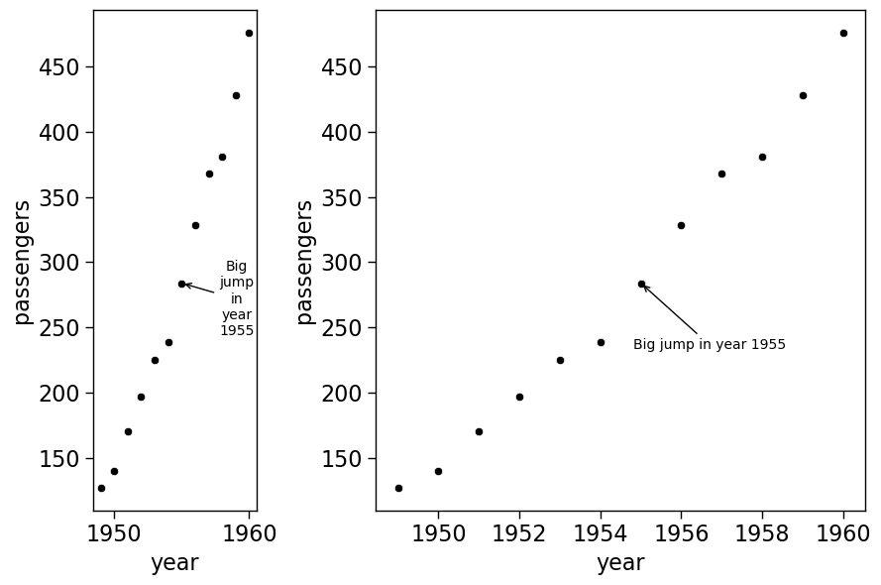


2. Prefer wider graphs
Easier to read time-series or causal data
Easier to label things
Advice from E. Tufte:
$$Width=1.5×Height$$
Or if you want to show off, use
$$Width=Height×φ$$

Slide 9
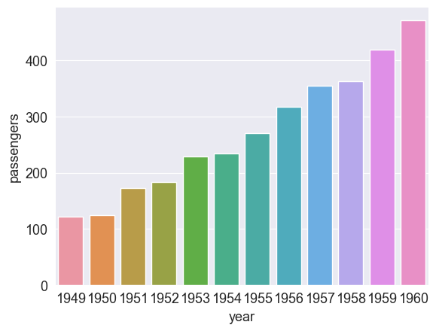
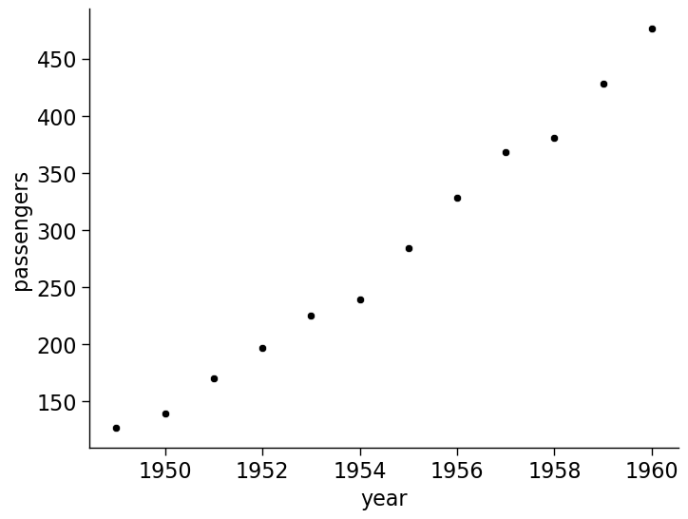

3. Maximise the data-to-ink ratio
$$Ratio=\frac{Ink in to display data}{Ink used in graphical display}$$
Remove background
Change
y-axis
Too many ticks
Useless colours

Slide 10
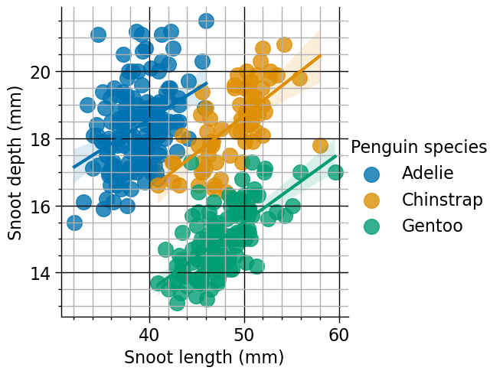
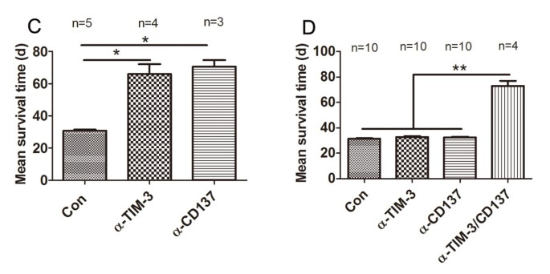
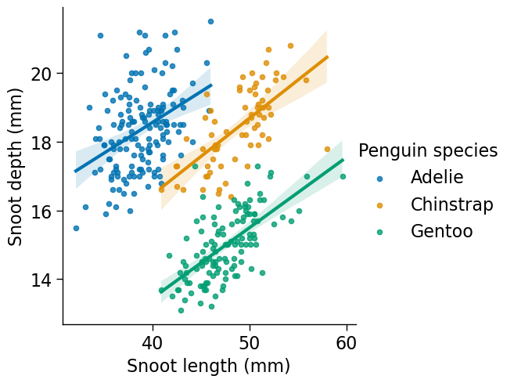
4. Avoid chartjunk
Source: https://doi.org/10.1186/1479-5876-11-215

Slide 11
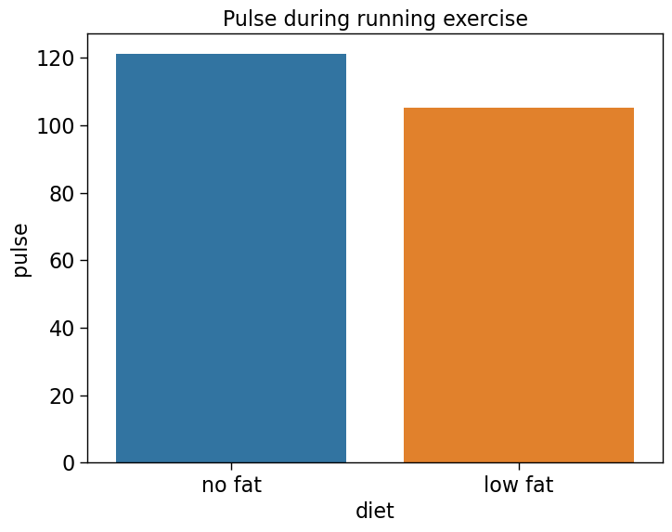
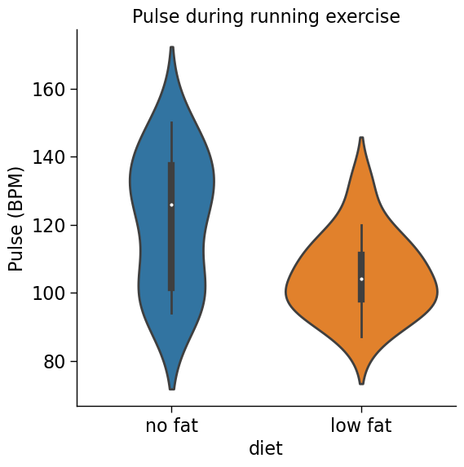
5. Maximise data density = number of entries in a plot
Number of points plotted = ?
Number of points plotted = ?
Source: https://github.com/mwaskom/seaborn-data

Slide 12
5. Maximise data density = number of entries in a plot
Number of points plotted = 2
Number of points plotted = 5 + distribution
Source: https://github.com/mwaskom/seaborn-data

Slide 13
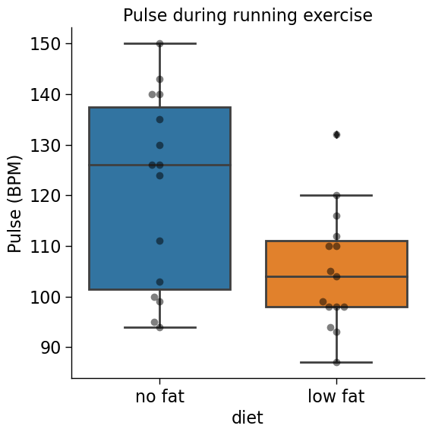
5. Maximise data density = number of entries in a plot
Number of points plotted = 2
Number of points plotted = 40
Source: https://github.com/mwaskom/seaborn-data

Slide 14
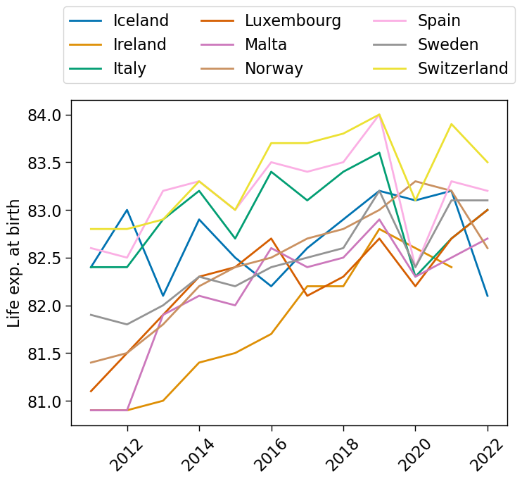
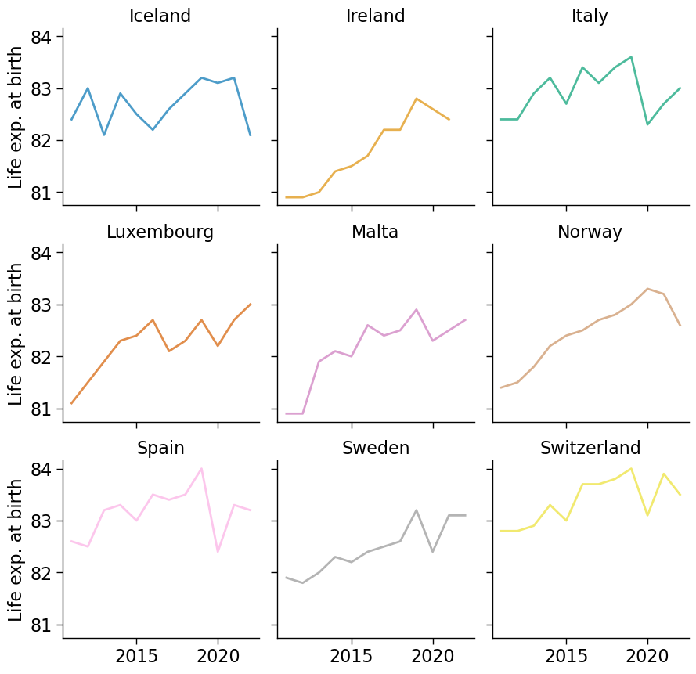
6. Shrink graphics whenever possible: small multiples
Source: https://ec.europa.eu/eurostat/databrowser/view/TPS00205/default/table?lang=en

Slide 15
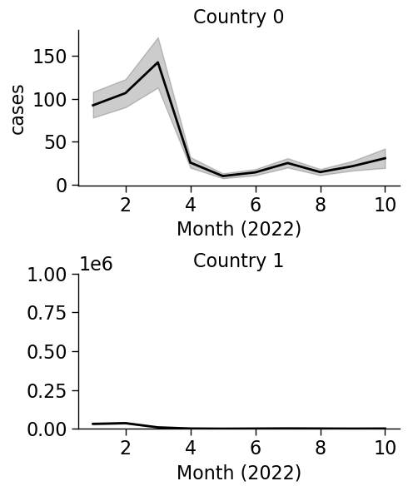
7. Axes: label them consistently, choose them wisely
1 minute: which country has the highest number of COVID cases?

Slide 16
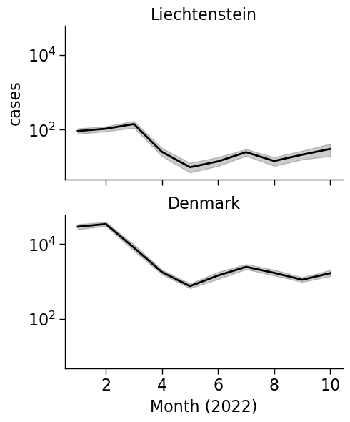
7. Axes: label them consistently, choose them wisely
Use the same scale when comparing subplots = easier comparison

Slide 17
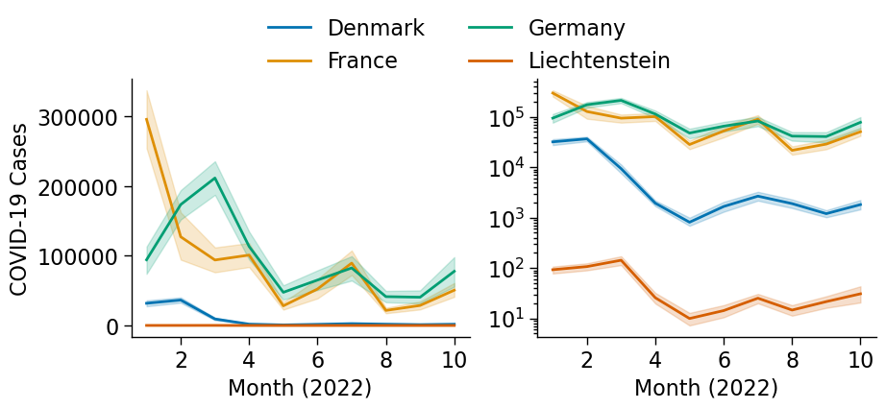
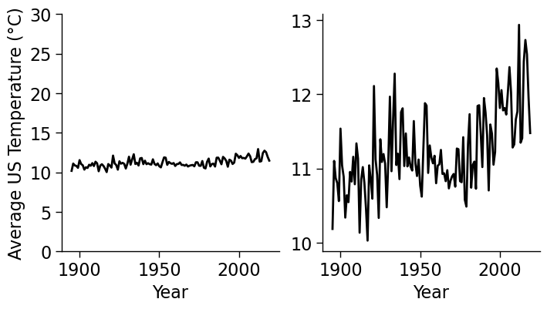
7. Axes: label them consistently, choose them wisely
Inappropriate scaling can hide variations
Use log scales when variation is large

Slide 18
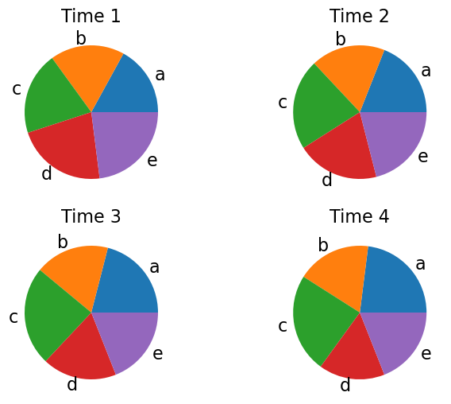
8. Patterns: some are more difficult to compare
Which groups (a, b, c, d, e) increased or decreased from time 1 to 4?
Inspired from: https://www.data-to-viz.com/caveat/pie.html

Slide 19
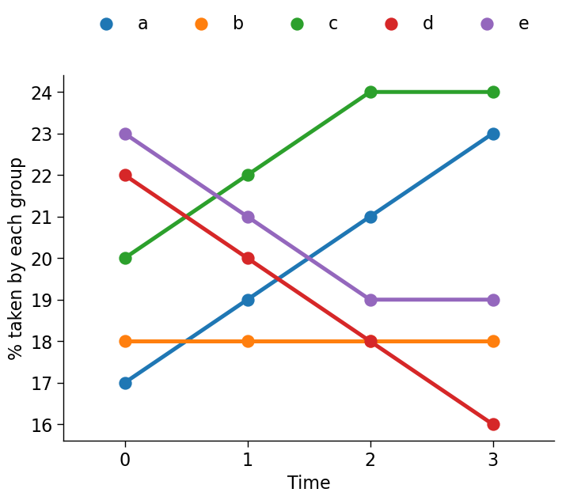
8. Patterns: some are more difficult to compare
Easier to read
Harder to read
Position
Length
Direction
Angle
Area
Volume
Colour
Inspired from: https://www.data-to-viz.com/caveat/pie.html

Slide 20



9. Colours: there are palette-ble solutions for all eyes
Colour blindness affects [1]:
8% of males
0.5% of females
Alternatives
Using a colourblind-friendly palette
Use high contrast designs
Normal
Protanopia
Deuteranopia
Tritanopia
Source:
https://www.nei.nih.gov/learn-about-eye-health/eye-conditions-and-diseases/color-blindness

Slide 21
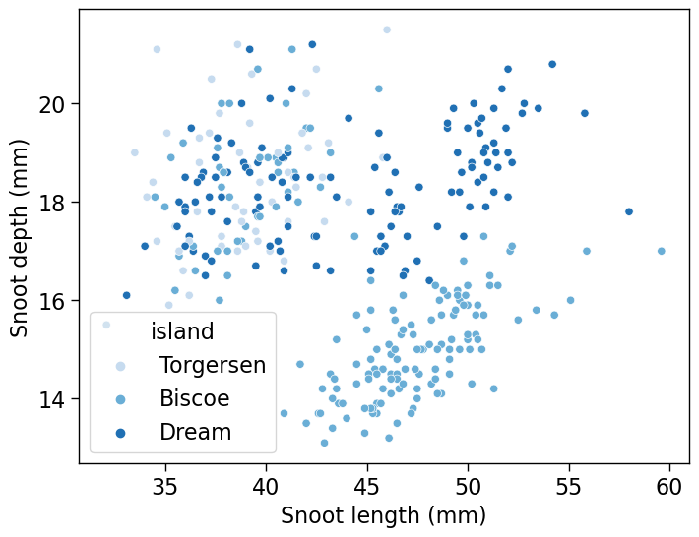
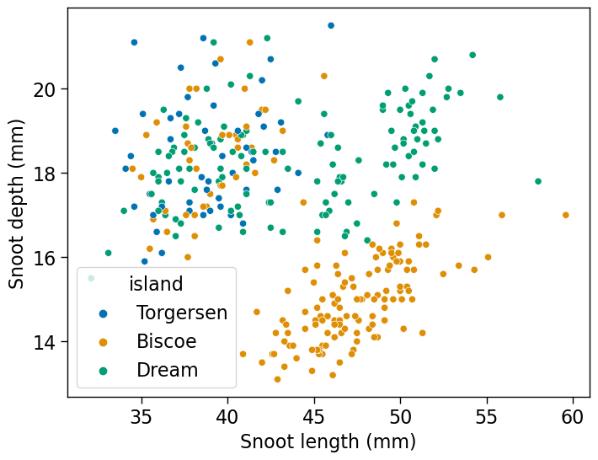
9. Colours: vary HUE to represent categories

Slide 22
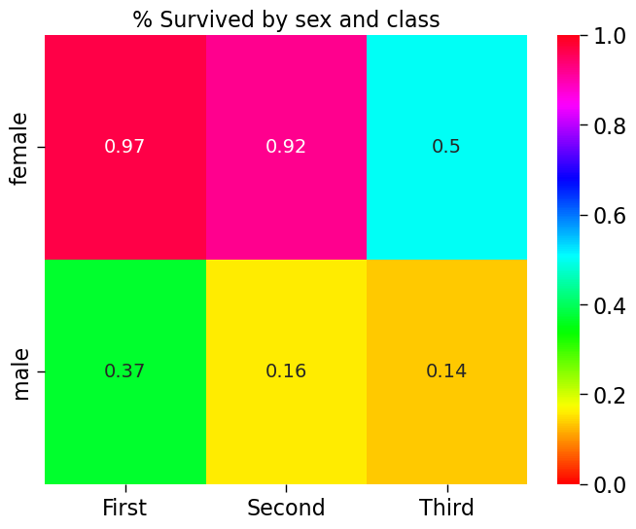
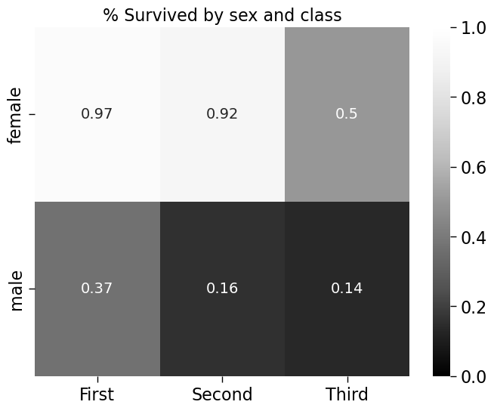
9. Colours: vary LUMINANCE to represent numbers

Slide 23
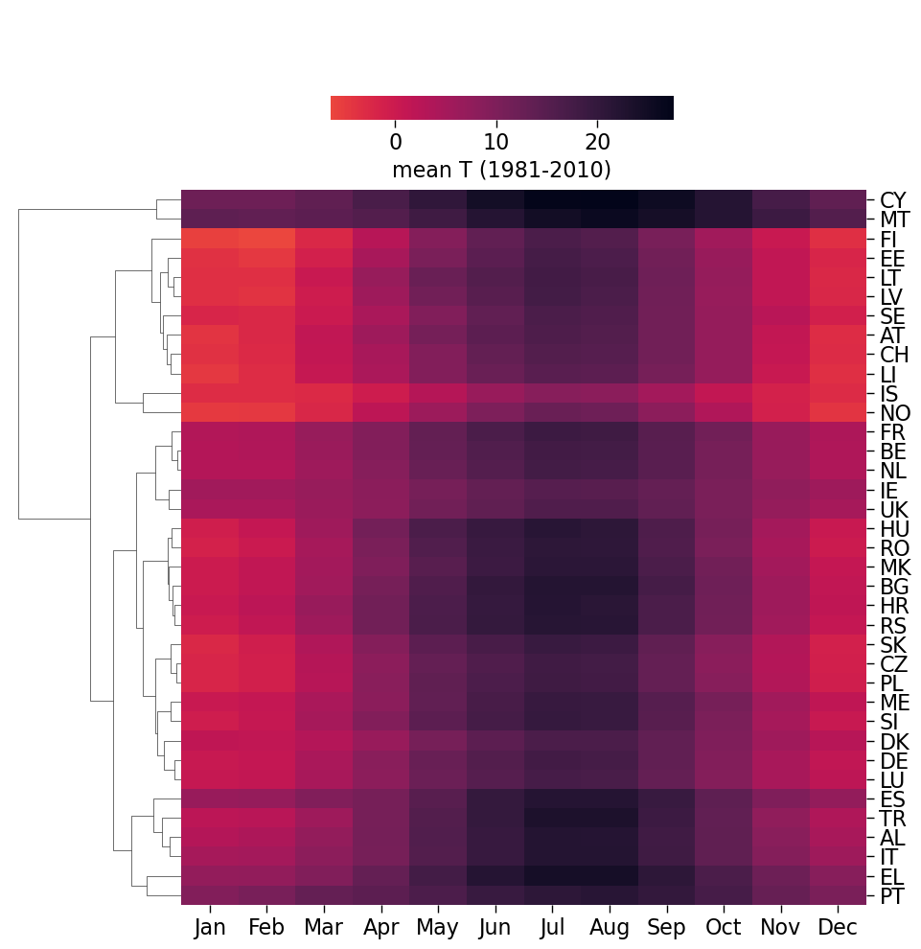
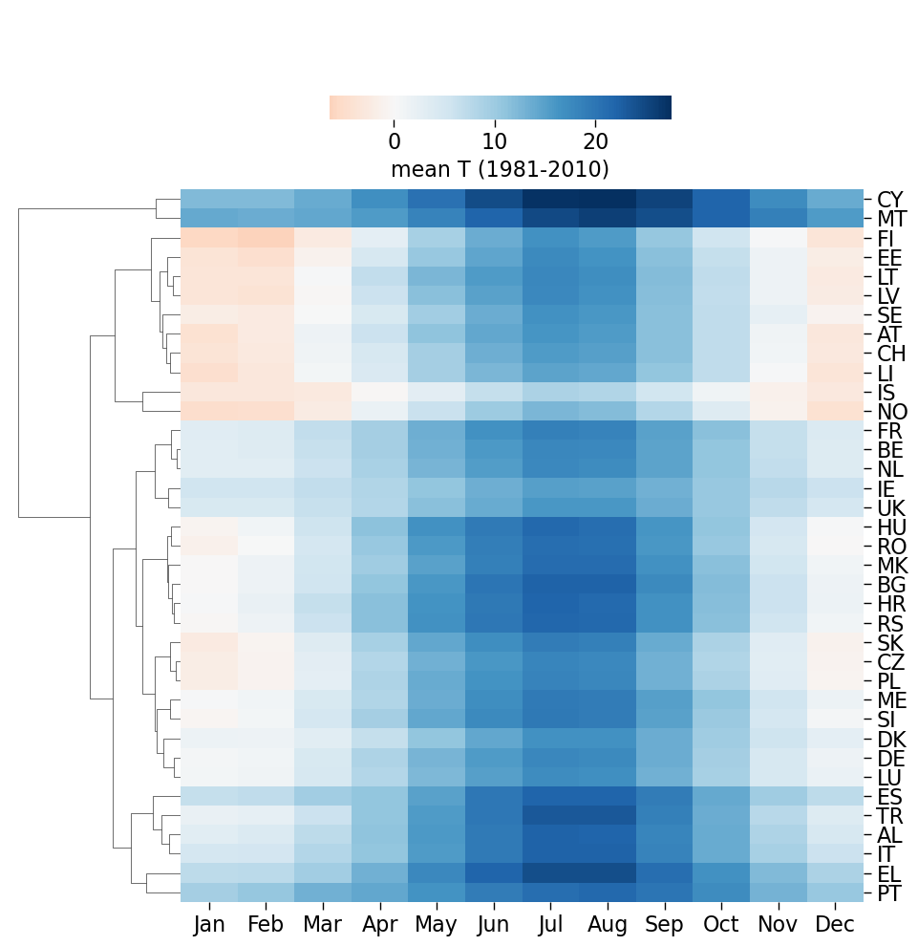
9. Colours: choose diverging palettes to emphasize low and high values

Slide 24
9. Colours: there are palette-ble solutions for all eyes
In R:
install.packages("viridis") # Good colour maps install.packages("RColorBrewer") # Good to design colour schemes
library(RColorBrewer)
##### Let’s create a new palette! #####
# Colorblind hex codes from Seaborn
colors <- c("#0173b2", "#de8f05", "#029e73", "#d55e00", "#cc78bc",
"#ca9161", "#fbafe4", "#949494", "#ece133", "#56b4e9")
# Create a custom palette
my_palette <- brewer.pal(n = length(colors), name = “colorblind")
# Replace the default colors with your specified colors
my_palette <- colors
# Display the palette
scales::show_col(my_palette)

Slide 25

10. Telling the truth is important (1)
“Stand Your Ground” reduced the number of deaths… or not??
The average temperature is not increasing… or not
Source: https://www.ncdc.noaa.gov/cag/
via https://climatereanalyzer.org/

Slide 26
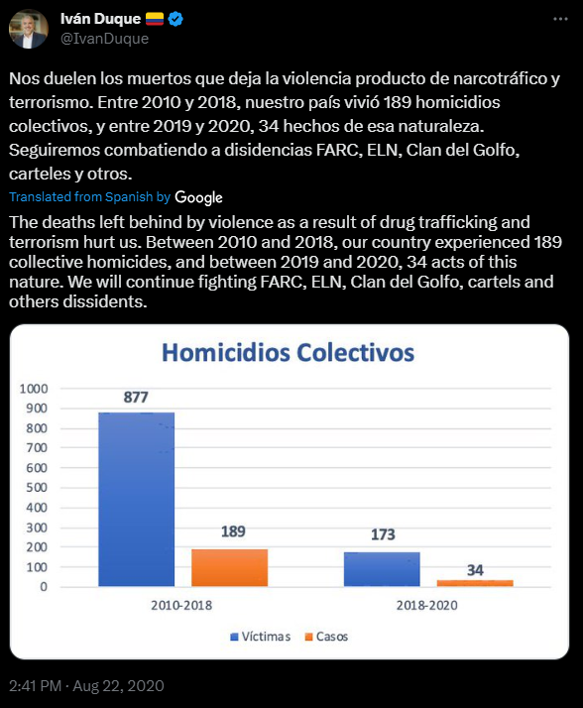
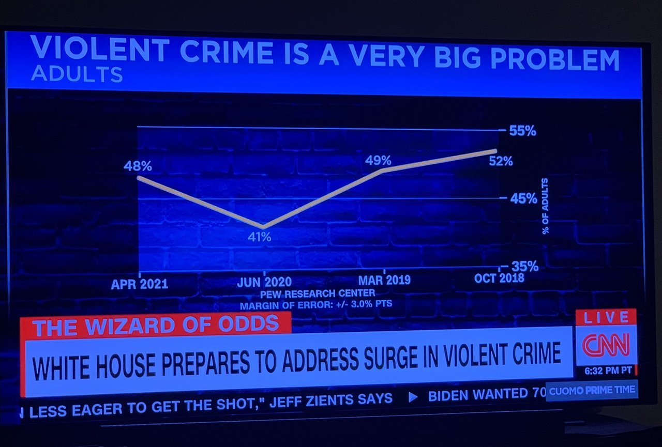
10. Telling the truth is important (2)
Source: https://twitter.com/IvanDuque/status/1297151862295199745
Credits to https://viz.wtf/

Slide 27
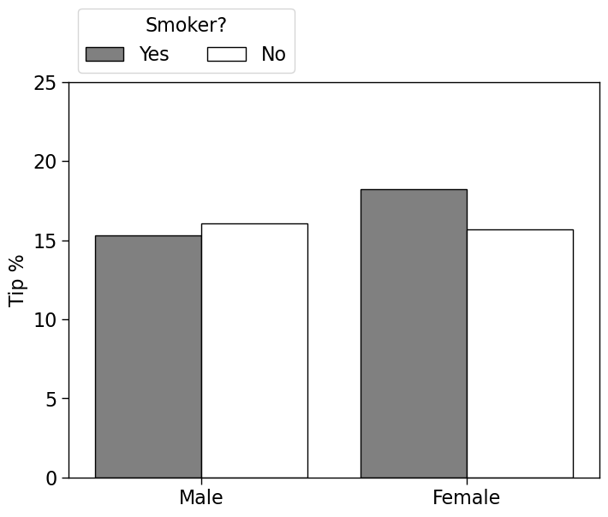
10. Telling the truth is important (3) Is there is uncertainty, show it!
Do women tip more than men?
Do smoker women tip more than non-smoker women?

Slide 28
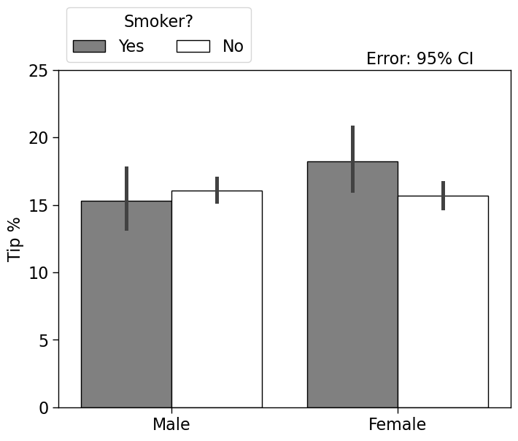
10. Telling the truth is important (3) Is there is uncertainty, show it!
t-test
p = 0.07
t-test
p = 0.25

Slide 29

Should you put caps at the end of error bars? Think about the data-to-ink ratio…
Added information: 0

Slide 30
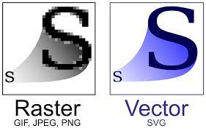
11. Choose a good image format
Raster graphics (.jpg, .png): photographs, digital art
Vector graphics (.pdf, .svg): graphs, plots, diagrams
Easily scalable without loss of quality

Slide 31
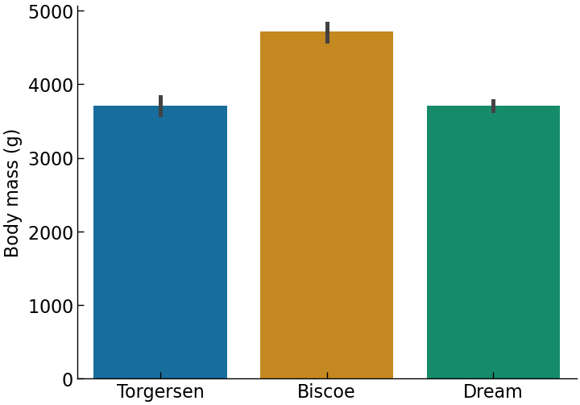
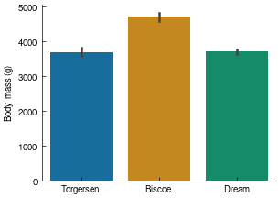
12. Change your plots depending on your output!
Large plots with large font sizes are good for slides
(here: font 16)
Small, concise plots are good for papers
(here: font 9)

Slide 32
Acknowledgement
Many of these slides were inspired by R. West’s “Applied Data Analysis” course at EPFL: https://docs.google.com/presentation/d/11eUfSrg84AWwnyl8sn3yMHKcGEm7JRc8-SCnhu9WImo/edit
Great course if you want to learn Python and learn more about data science methods!
And of course, by E. Tufte’s The Visual Display of Quantitative Information

